Slide 1

About me
Associate prof. dr. Sven Degroeve (sven.degroeve@ugent.be), Staff Scientist at CompOmics, VIB-CMB
Master in Information Technology (1999)
Title of thesis: “Classification of skin lesions with neural networks”
PhD in Computer Science (2004)
Title of thesis: “Design and evaluation of a linear classification strategy for gene structural element recognition”
Member of the study programme and the IT committee
https://sdgroeve.github.io/
Machine Learning Methods for Biomedical Data (D012554)

Slide 2
About me
Associate prof. dr. Sven Degroeve (sven.degroeve@ugent.be), Staff Scientist at CompOmics, VIB-CMB
Master in Information Technology (1999)
Title of thesis: “Classification of skin lesions with neural networks”
PhD in Computer Science (2004)
Title of thesis: “Design and evaluation of a linear classification strategy for gene structural element recognition”
Member of the study programme and the IT committee
https://sdgroeve.github.io/
Machine Learning Methods for Biomedical Data (D012554)

Slide 3
About the course
Full calendar on Ufora
2/4 and 3/4 practicum in the afternoon: assignment 1 part 1 (due 3/4)
https://www.kaggle.com/competitions/splice-site-prediction-contest
Link to join: https://www.kaggle.com/t/e3d467bfa7db464199bcbccccced8433
6/5 assignment 1 part 2 due
16/5 assignment 2 due
Microteaching: 16/5 full day presentations
7/5 and 8/5 major internship systems biology project (due 16/5)
Machine Learning Methods for Biomedical Data (D012554)

Slide 4

About the course
https://github.com/sdgroeve/Machine_Learning_course_UGent_D012554_2025
Machine Learning Methods for Biomedical Data (D012554)

Slide 5


About the course
coursera.org/specializations/machine-learning-introduction
3blue1brown.com
Machine Learning Methods for Biomedical Data (D012554)

Slide 6

(Classical) Machine Learning
Xkdc
Machine Learning Methods for Biomedical Data (D012554)

Slide 7
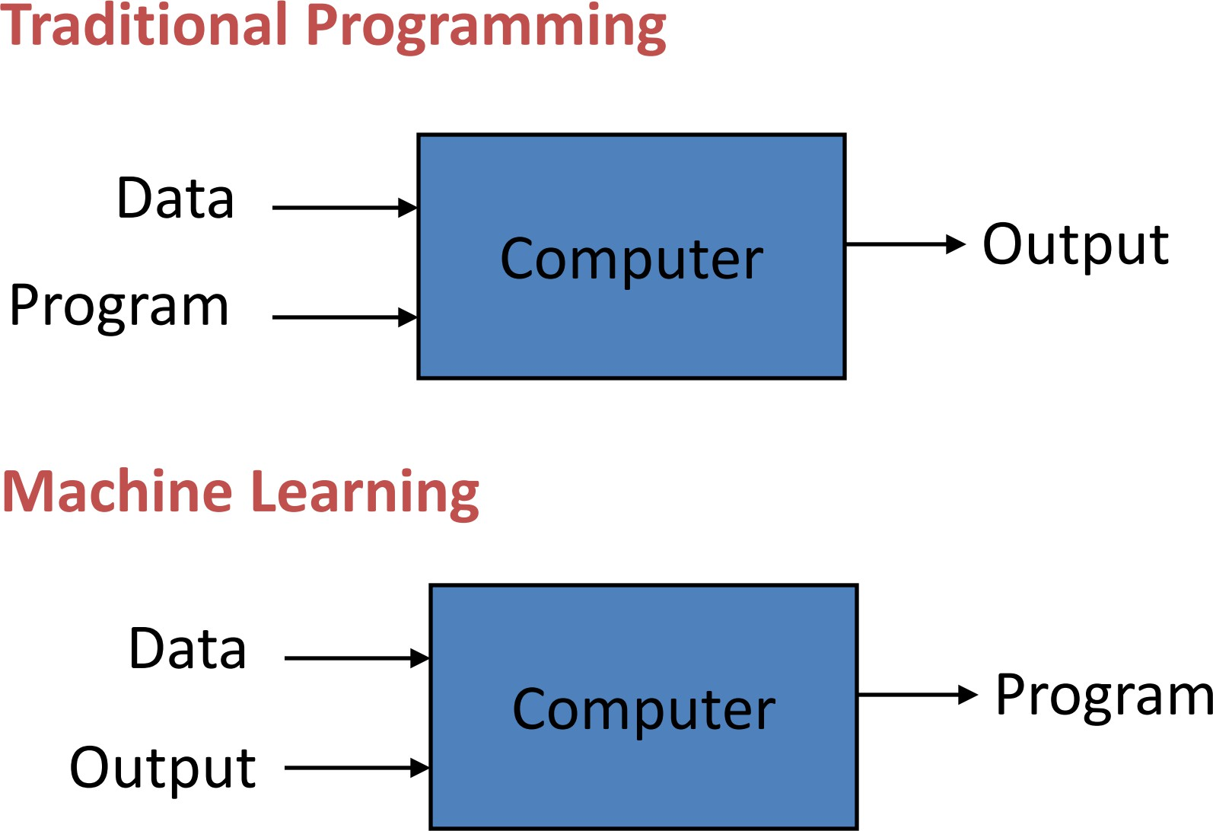
Machine Learning
Slide: Pedro Domingos
Machine Learning Methods for Biomedical Data (D012554)
Notes:
It is about how we think we should be solving problems.

Slide 8
Machine Learning
“A computer program is said to learn from experience E with respect to some class of tasks T and performance measure P, if its performance at tasks in T, as measured by P, improves with experience E.”
-- Tom Mitchell
Machine Learning Methods for Biomedical Data (D012554)

Slide 9
Machine Learning
“A computer program is said to learn from experience E with respect to some class of tasks T and performance measure P, if its performance at tasks in T, as measured by P, improves with experience E.”
-- Tom Mitchell
Machine Learning Methods for Biomedical Data (D012554)

Slide 10
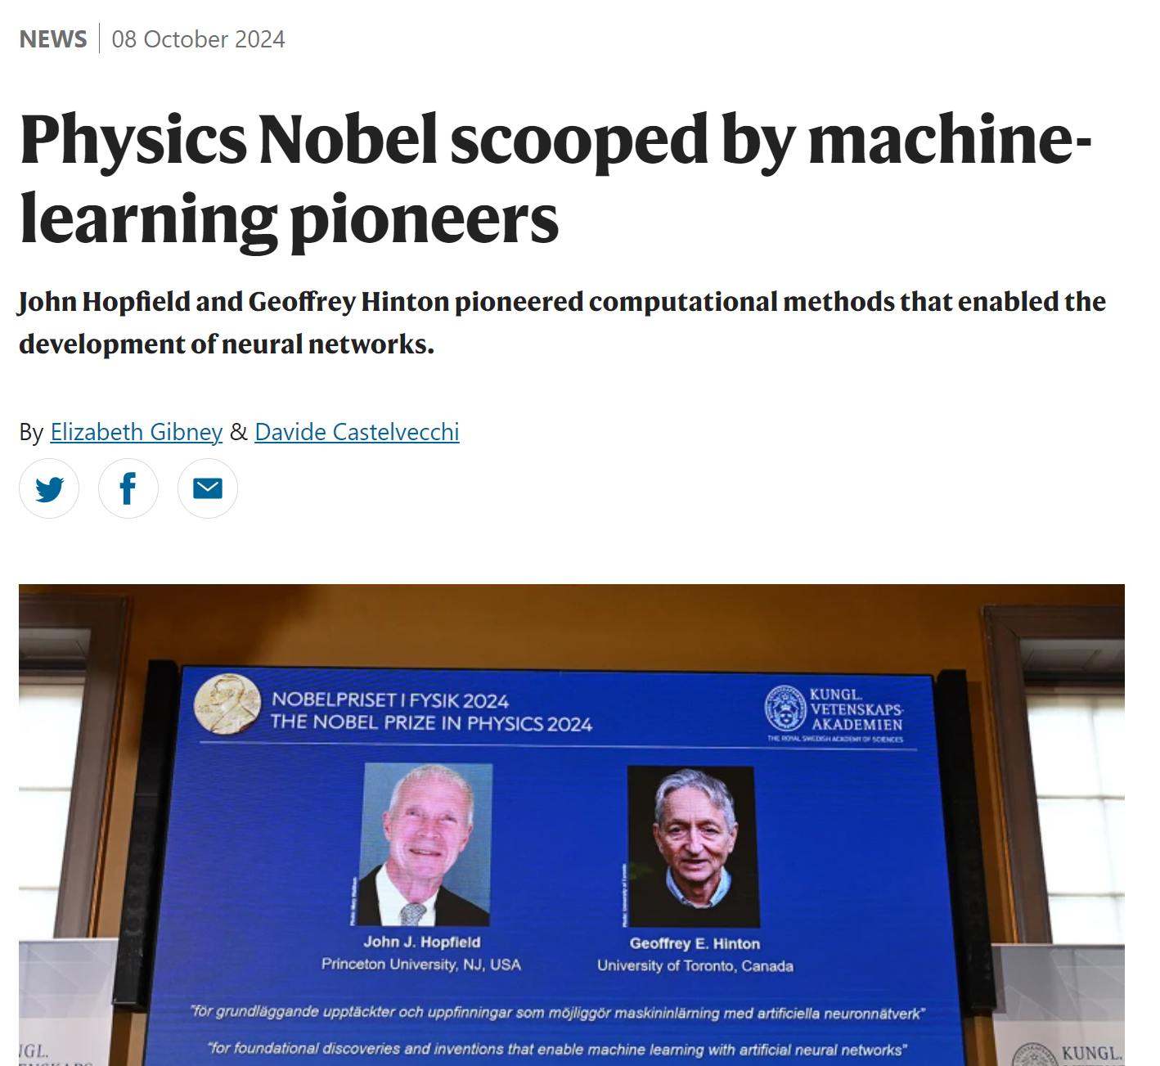
Machine Learning Methods for Biomedical Data (D012554)

Slide 11
Biomedical Applications
Medical Imaging Analysis: Machine learning enhances the detection of diseases in medical images (e.g., X-rays, MRIs, CT scans) by identifying patterns indicative of conditions like cancer, fractures, and neurological disorders.
Genomics and Drug Discovery: ML models analyse vast genomic data to identify genetic mutations, predict disease susceptibility, and accelerate drug discovery by simulating molecular interactions.
Personalized Medicine: Machine learning helps tailor treatments based on an individual’s genetic profile, medical history, and response to previous treatments, improving patient outcomes.
Predictive Diagnostics: AI models analyse patient data (e.g., electronic health records, biomarkers) to predict disease onset, progression, and potential complications, enabling early intervention.
Healthcare Automation: ML-powered chatbots, virtual assistants, and administrative tools streamline tasks like patient triaging, medical documentation, and hospital resource allocation.
Machine Learning Methods for Biomedical Data (D012554)

Slide 12
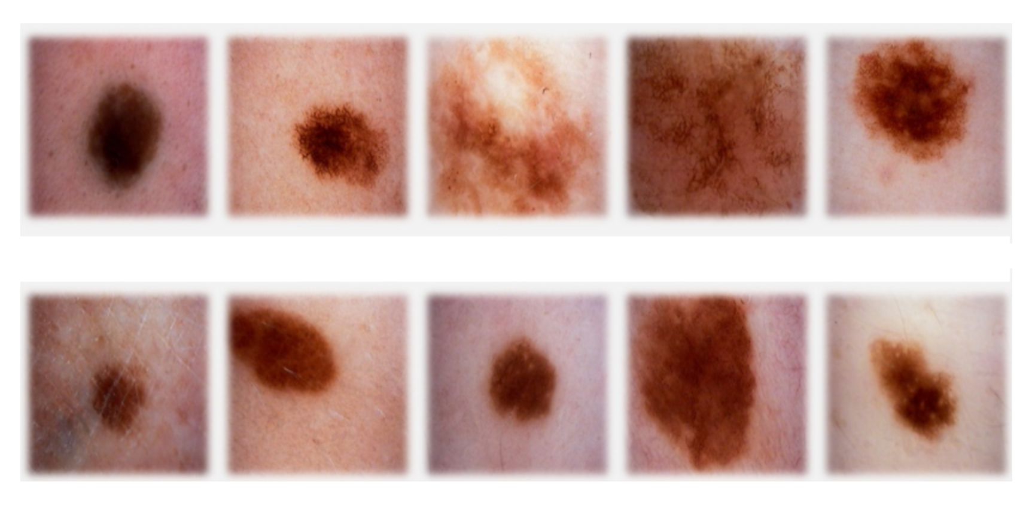
Classification
sign of cancer
top row malignant
bottom row benign
Machine Learning Methods for Biomedical Data (D012554)

Slide 13
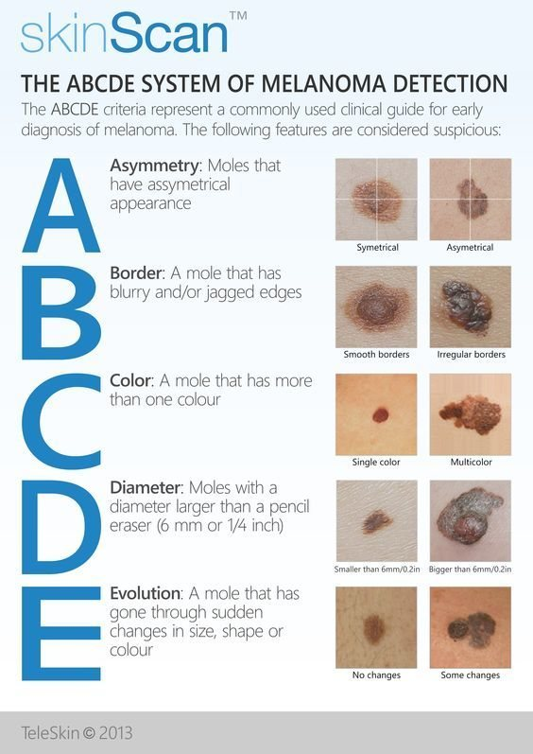
Classification
Machine Learning Methods for Biomedical Data (D012554)

Slide 14
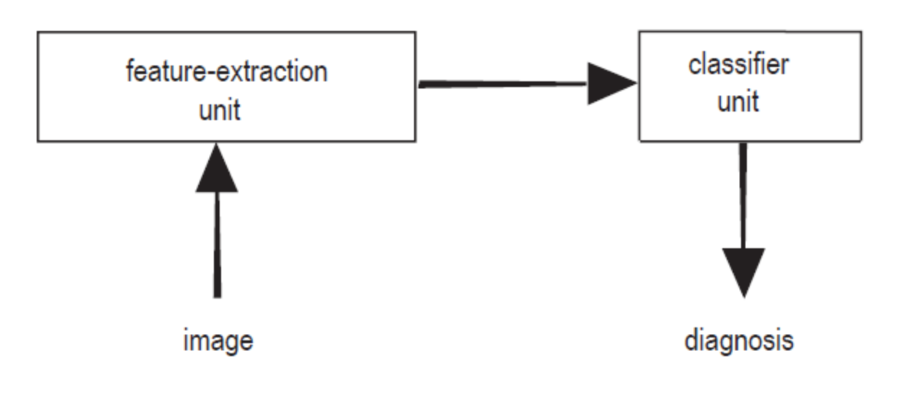
Classification: terminology
feature extraction: features (a.k.a. properties or attributes)
data set, sample (a.k.a. example, instance or data point), label (a.k.a. target)
Machine Learning Methods for Biomedical Data (D012554)

Slide 15
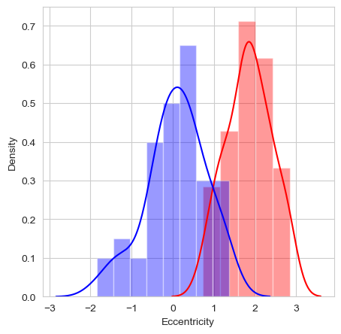
Classification: a feature
feature: eccentricity of lesion (how nearly circular the lesion is)
Machine Learning Methods for Biomedical Data (D012554)

Slide 16

Classification: the model
feature: eccentricity of lesion (how nearly circular the lesion is)
model: threshold t
Machine Learning Methods for Biomedical Data (D012554)

Slide 17
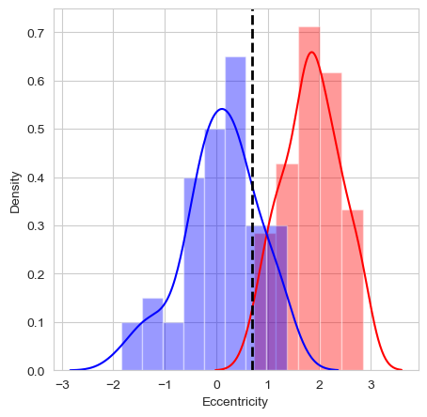
Classification: the model
feature: eccentricity of lesion (how nearly circular the lesion is)
model: threshold t: consequence of the predictions
Machine Learning Methods for Biomedical Data (D012554)

Slide 18
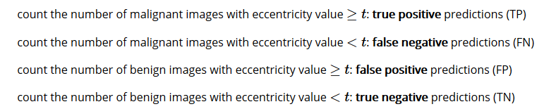
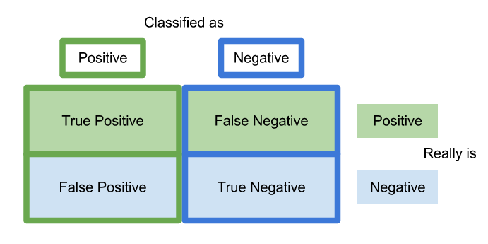
Classification: prediction errors
malignant: positive class
benign: negative class
Machine Learning Methods for Biomedical Data (D012554)

Slide 19
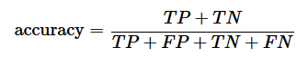
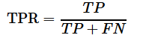
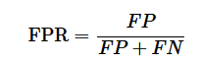
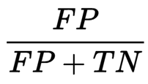
Classification: prediction errors
Machine Learning Methods for Biomedical Data (D012554)

Slide 20
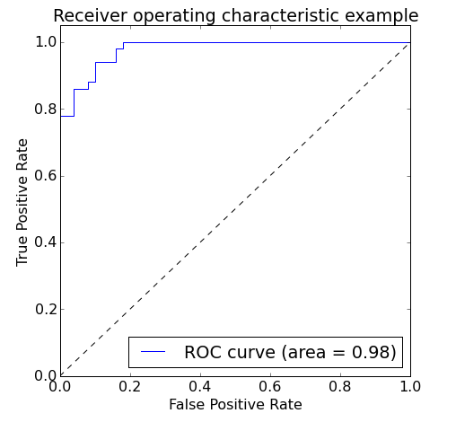
Classification: prediction errors
model that classifies all images as malignant: TPR=1 and FPR=1
model that classifies all images a benign: TPR=0 and FPR=0
vary threshold t
Area Under the Curve (AUC)
Machine Learning Methods for Biomedical Data (D012554)

Slide 21
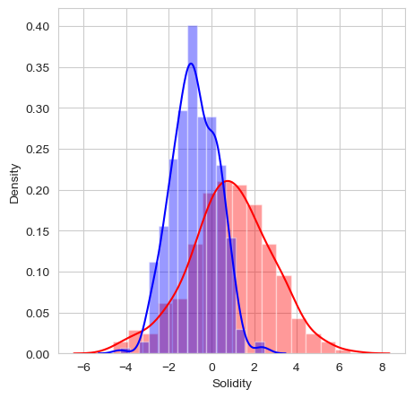
Classification: multi-dimensional
add another feature?
feature vector X
Euclidean vector space
Machine Learning Methods for Biomedical Data (D012554)

Slide 22
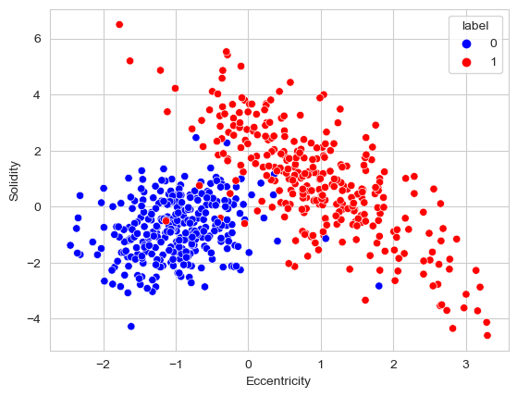
Classification: multi-dimensional
feature vector X
Euclidean vector space
Machine Learning Methods for Biomedical Data (D012554)

Slide 23
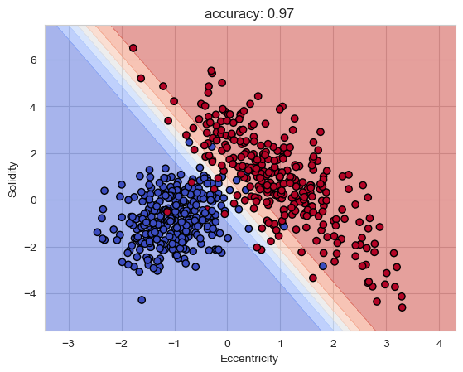
Classification: multi-dimensional
linear decision boundary
blue region malignant, red region benign
yet more features
can’t look at the decision boundary
more complex
Machine Learning Methods for Biomedical Data (D012554)

Slide 24
Decision tree
A decision tree is a supervised machine learning algorithm used for classification and regression tasks. It models decisions and their possible consequences in a tree-like structure, where nodes represent features, branches represent decision rules, and leaves represent outcomes.
Decision trees split data based on feature values, using criteria like Gini impurity or entropy (information gain) in classification, and mean squared error (MSE) in regression. They recursively divide the dataset into subsets to make predictions.
They are interpretable and easy to understand but prone to overfitting, which can be mitigated by techniques like pruning or max depth limitation.
The concept of decision trees dates back to the 1960s, with ID3 being a notable early algorithm introduced by Ross Quinlan in 1986.
Machine Learning Methods for Biomedical Data (D012554)

Slide 25

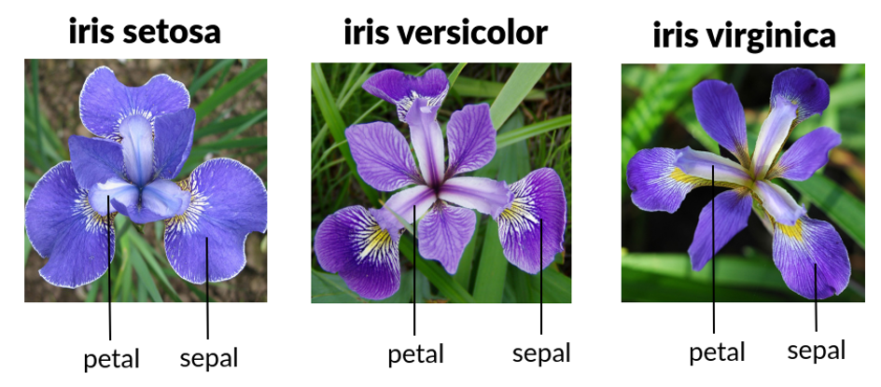
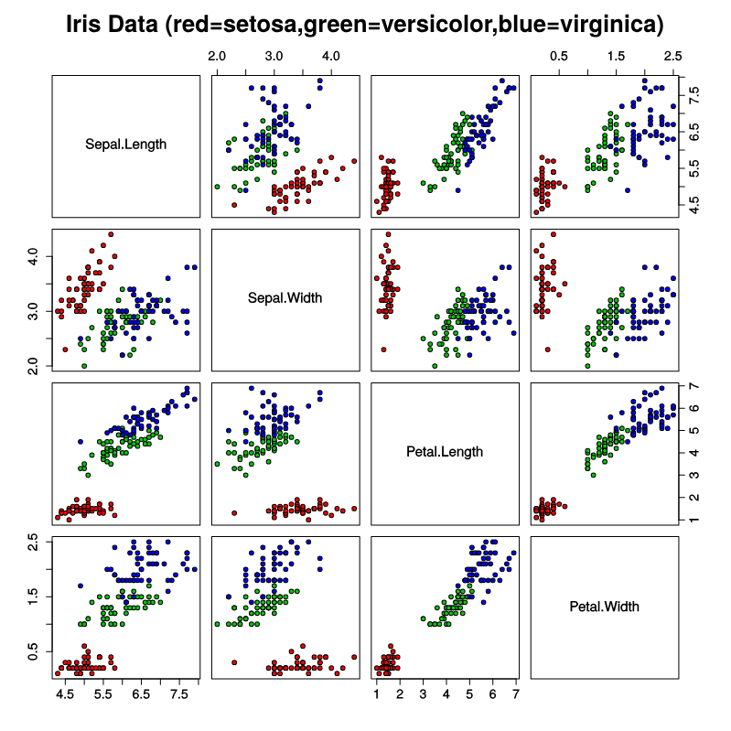
Iris dataset
Fisher, R.A. (1936) The Use of Multiple Measurements in Taxonomic Problems. Annals Eugenics, 7, 179-188.
Machine Learning Methods for Biomedical Data (D012554)

Slide 26
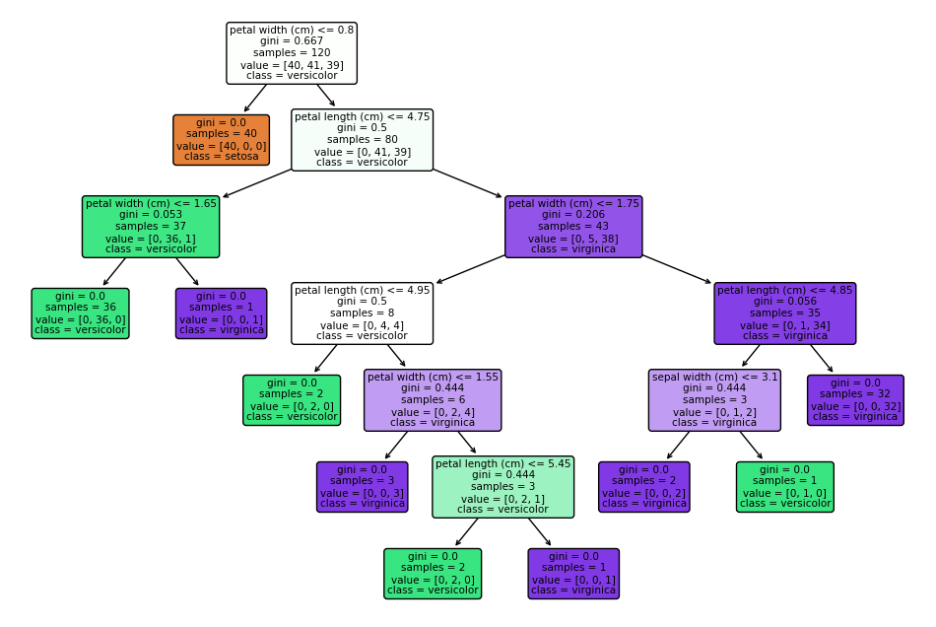
Decision tree
Machine Learning Methods for Biomedical Data (D012554)

Slide 27
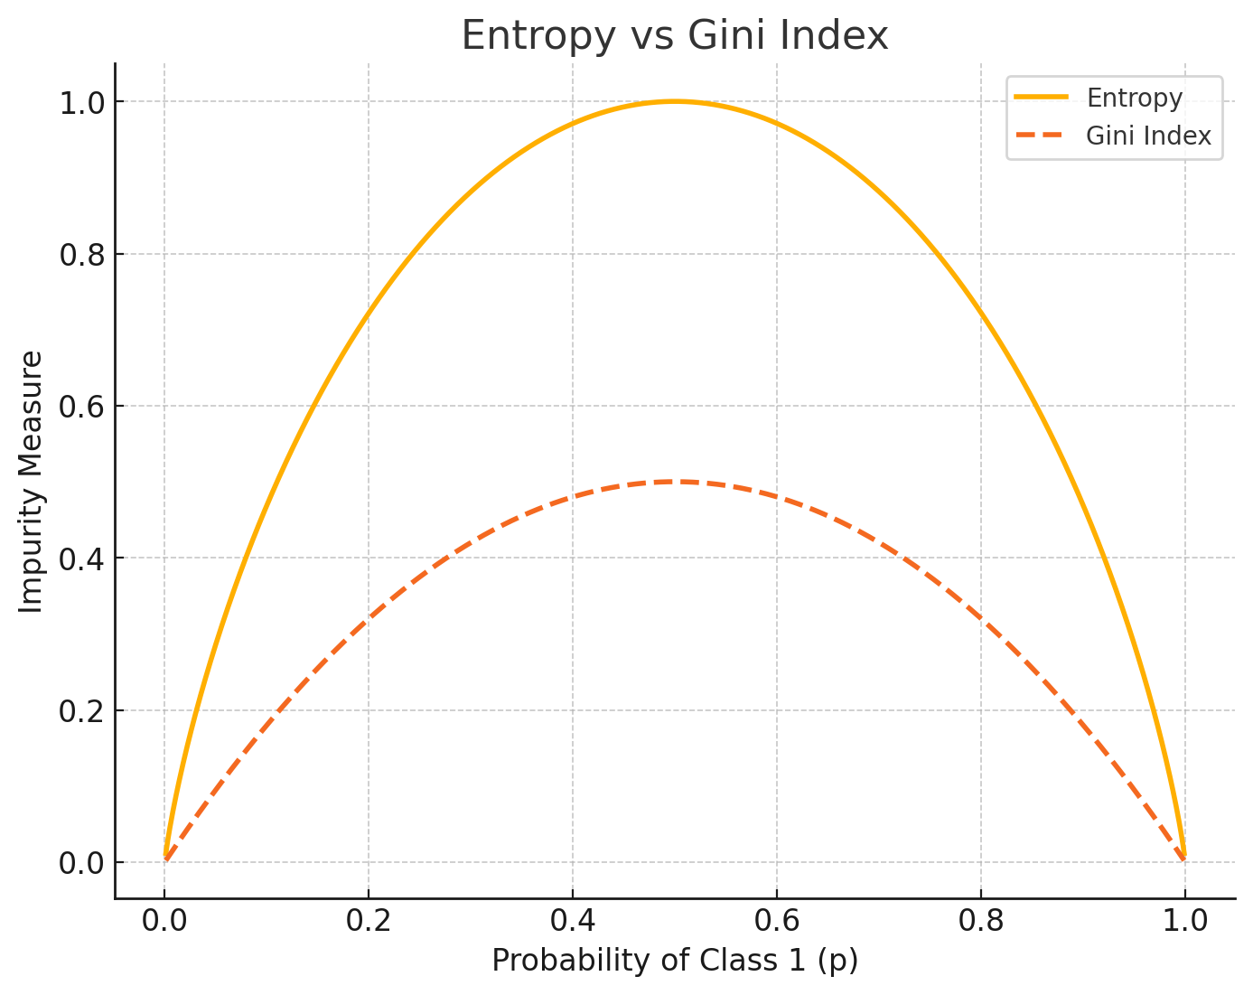
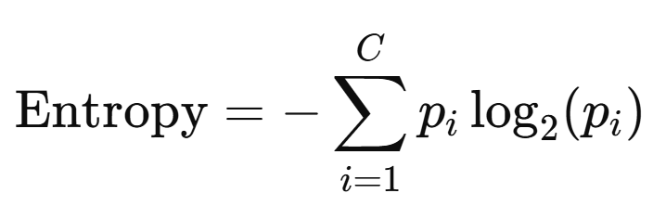
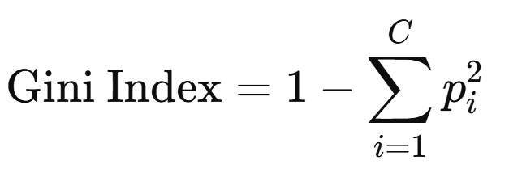
Decision tree
Machine Learning Methods for Biomedical Data (D012554)

Slide 28
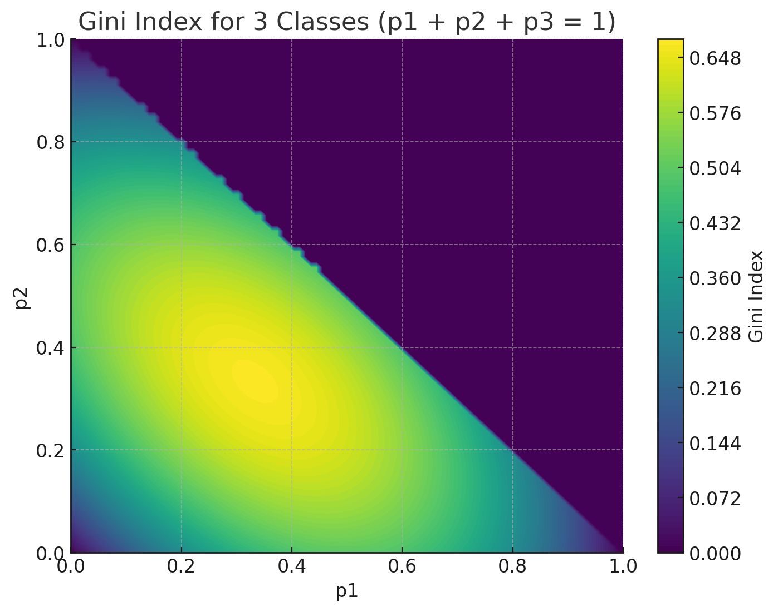
Decision tree
Machine Learning Methods for Biomedical Data (D012554)

Slide 29
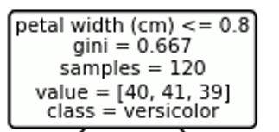
Decision tree
Machine Learning Methods for Biomedical Data (D012554)

Slide 30
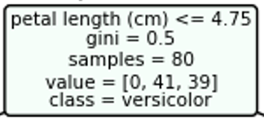
Decision tree
Machine Learning Methods for Biomedical Data (D012554)

Slide 31
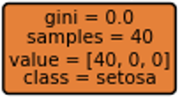
Decision tree
Machine Learning Methods for Biomedical Data (D012554)

Slide 32
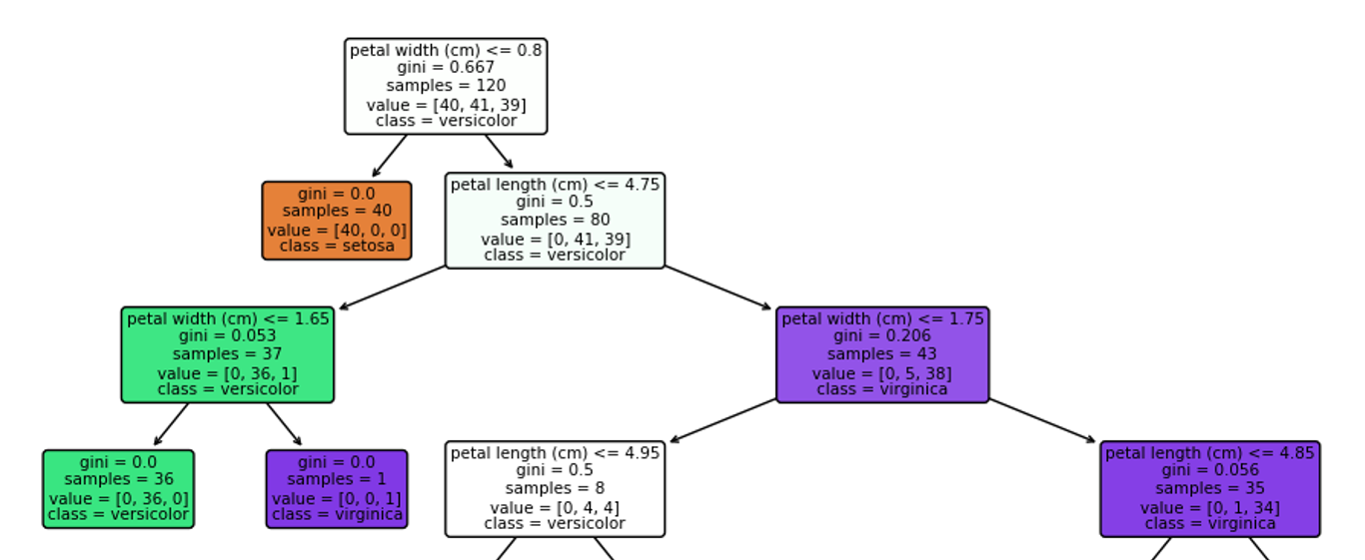
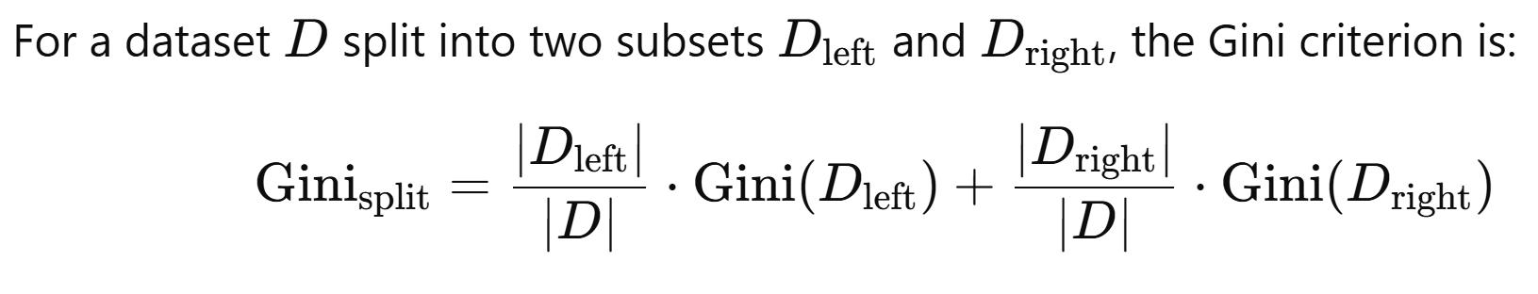
Decision tree
Machine Learning Methods for Biomedical Data (D012554)

Slide 33
Model evaluation: train-test split
By separating data into training and testing sets, the model learns patterns from training data while being evaluated on unseen data, ensuring it generalizes well to new inputs.
The test set provides an independent dataset to measure model performance, helping to assess accuracy, precision, recall, and other metrics objectively.
Machine Learning Methods for Biomedical Data (D012554)

Slide 34
Model evaluation: train-test split
overfitting.ipynb
Machine Learning Methods for Biomedical Data (D012554)

Slide 35
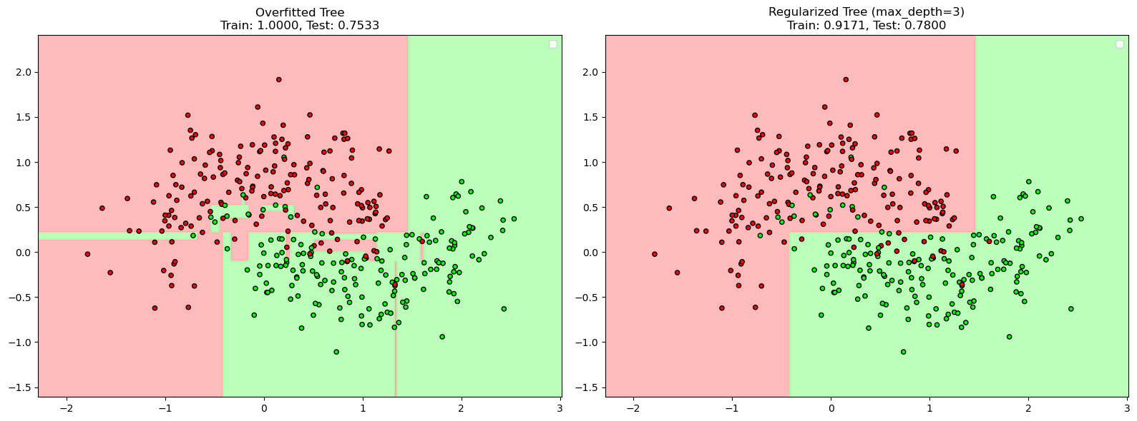
Classification: model complexity
Machine Learning Methods for Biomedical Data (D012554)

Slide 36
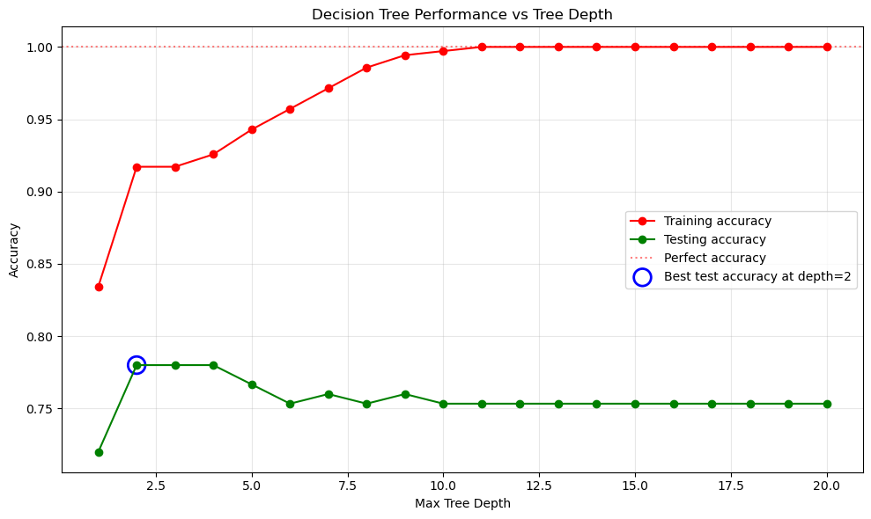
Classification: model complexity
Machine Learning Methods for Biomedical Data (D012554)

Slide 37
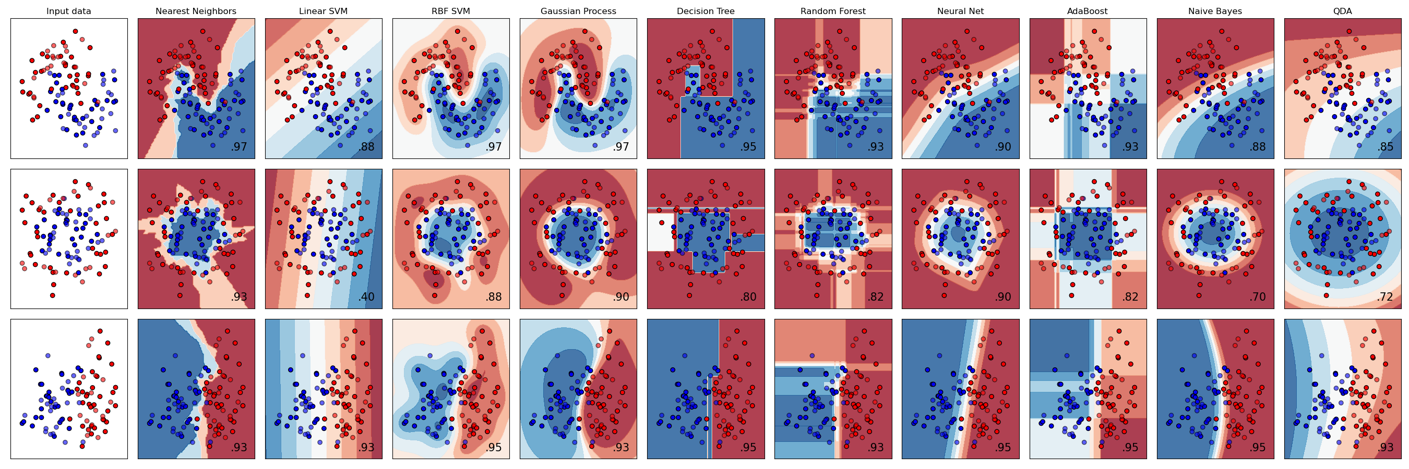
Scikit-learn
Machine Learning Methods for Biomedical Data (D012554)

Slide 38
Model evaluation: k-fold cross-validation
Cross-validation is a technique to evaluate model performance by splitting the dataset into multiple training and validation sets, reducing bias from a single train-test split.
K-fold cross-validation is the most common method, where the dataset is divided into k folds, and the model is trained and validated k times, with each fold serving as a validation set once.
It helps prevent overfitting and improves model selection, especially in hyperparameter tuning, by providing a more reliable estimate of generalization performance.
Machine Learning Methods for Biomedical Data (D012554)

Slide 39

Model evaluation: k-fold cross-validation
Machine Learning Methods for Biomedical Data (D012554)

Slide 40
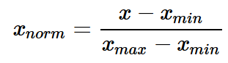
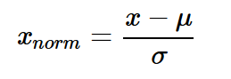
Data normalization
Without normalization, features with larger numerical ranges can dominate model training, leading to biased weight updates.
Normalization helps optimization algorithms like gradient descent converge faster by ensuring consistent feature magnitudes, reducing the risk of slow or unstable learning.
Methods include Min-Max Scaling and Standardization, where Min-Max Scaling rescales values within a fixed range, and Standardization (Z-score normalization) ensures features have a mean of 0 and standard deviation of 1
Machine Learning Methods for Biomedical Data (D012554)

Slide 41
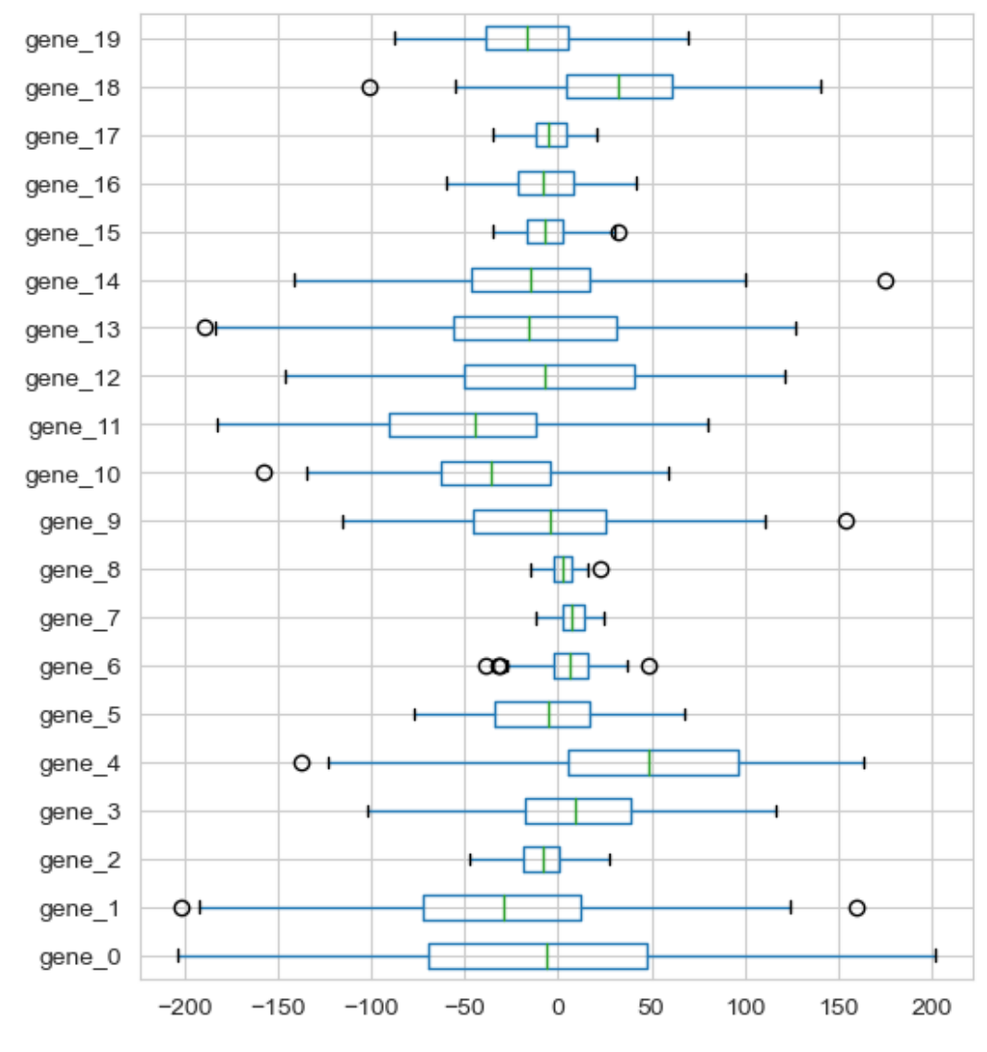
Data normalization
Machine Learning Methods for Biomedical Data (D012554)

Slide 42
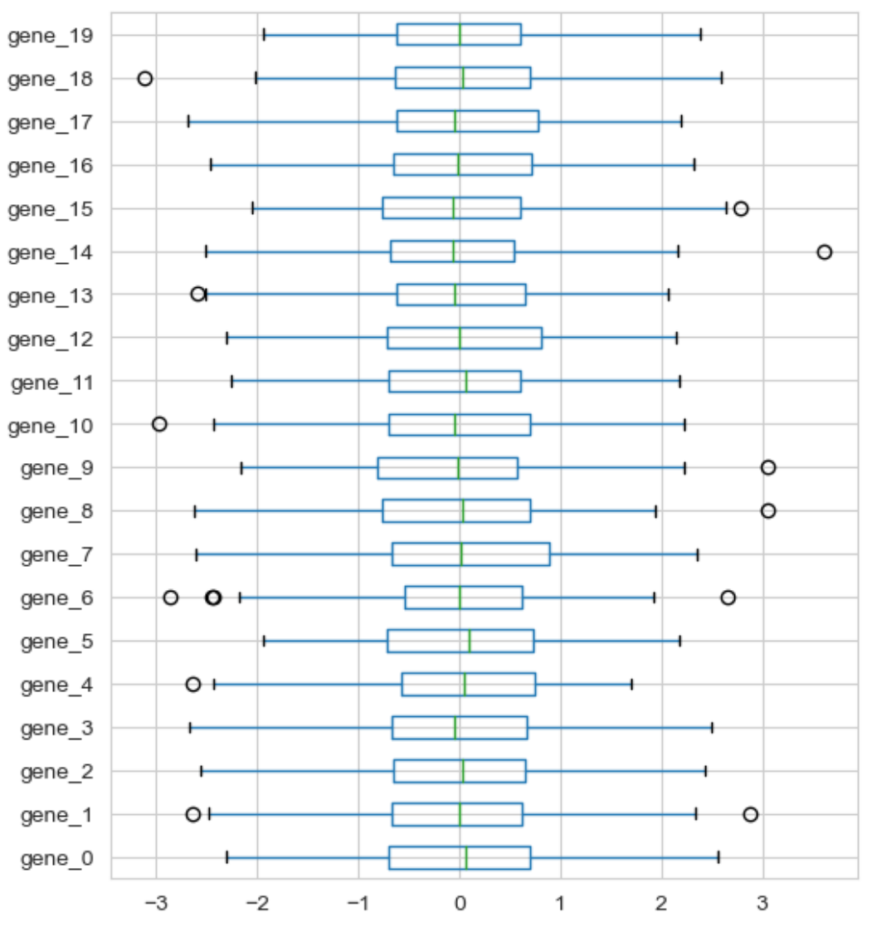
Data normalization: standardization
Machine Learning Methods for Biomedical Data (D012554)

Slide 43
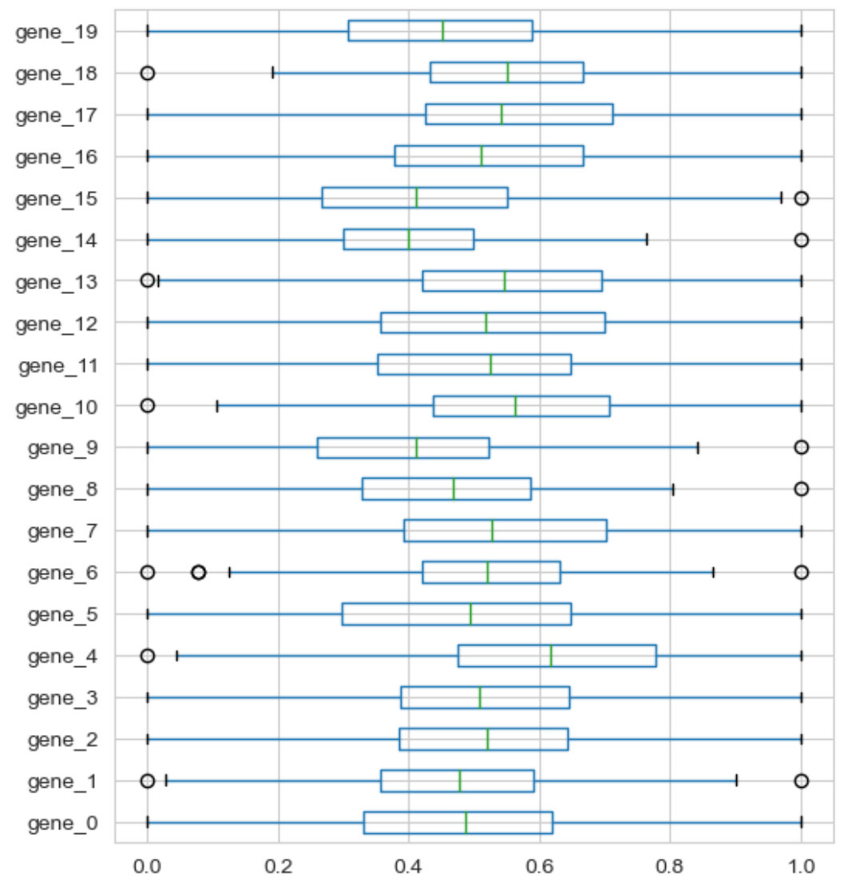
Data normalization: min-max scaling
Machine Learning Methods for Biomedical Data (D012554)

Slide 44
Data leakage
Data leakage occurs when information from the test set influences the model during training.
If preprocessing (e.g., scaling, imputation) is done before splitting, the statistics (e.g., mean, standard deviation, min-max values) are computed on the entire dataset.
This means the test data indirectly influences the transformations applied to the training data, which violates the principle that the test set should remain unseen until final evaluation.
Machine Learning Methods for Biomedical Data (D012554)

Slide 45
Data preprocessing
data_preprocessing.ipynb
Machine Learning Methods for Biomedical Data (D012554)

Slide 46
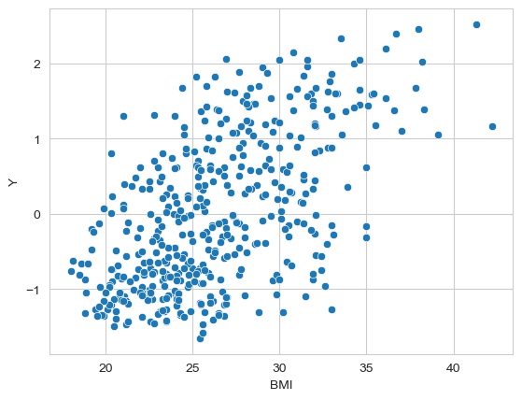
Regression
Can BMI explain Y?
Can BMI predict Y?
How does Y vary with BMI?
Regression is a general term for modeling the relationship between a label
(a.k.a. dependent variable or target) and one or more features (a.k.a. the attributes, the independent or explanatory variable(s)).
Machine Learning Methods for Biomedical Data (D012554)

Slide 47
Linear regression
Linear regression models the relationship between input features (X) and a target variable (Y) using a linear equation: 𝑌=𝑤𝑋+𝑏, where 𝑤 represents the weight (slope) and 𝑏 is the bias (intercept).
It minimizes the error using the least squares method, which finds the best-fit line by reducing the sum of squared differences between actual and predicted values.
Simple Linear Regression involves one independent variable, while Multiple Linear Regression extends this to multiple input features, allowing for more complex predictions.
Machine Learning Methods for Biomedical Data (D012554)

Slide 48
Linear regression
We need to make
assumptions
about the
model
that generated the data.
linear relationship
linear model
Machine Learning Methods for Biomedical Data (D012554)

Slide 49
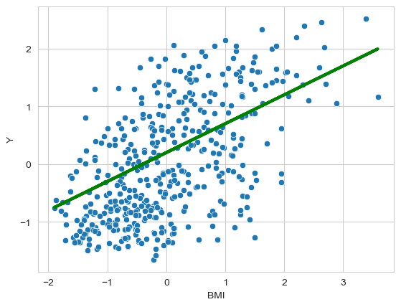
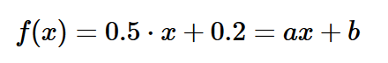
Linear regression
a and b are model parameters
a is the slope to the line (direction)
b is the intercept or bias (position)
Machine Learning Methods for Biomedical Data (D012554)

Slide 50
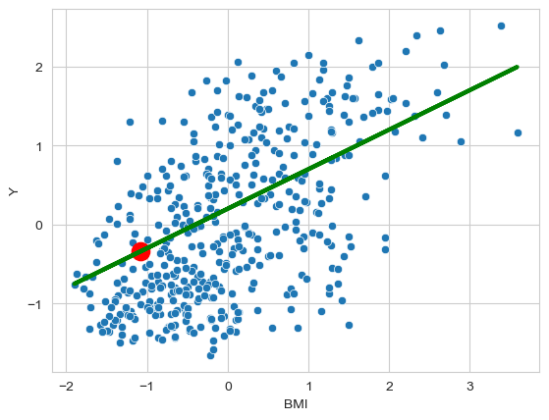
Linear regression: prediction
BMI(70kg, 1.8 meter) = 21.6
scaled data!
scaled BMI = -1.08
predicted value = -0.34
generalization!!
Machine Learning Methods for Biomedical Data (D012554)

Slide 51
Linear regression: fitting
What values for a and b fit the data best?
How can we evaluate them?
Machine Learning Methods for Biomedical Data (D012554)

Slide 52
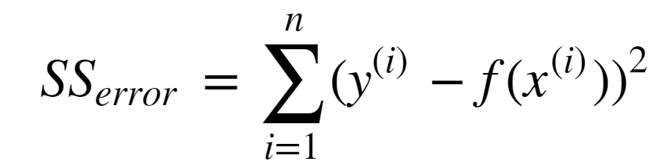
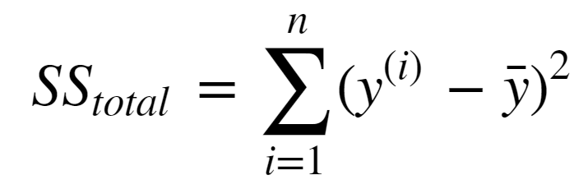
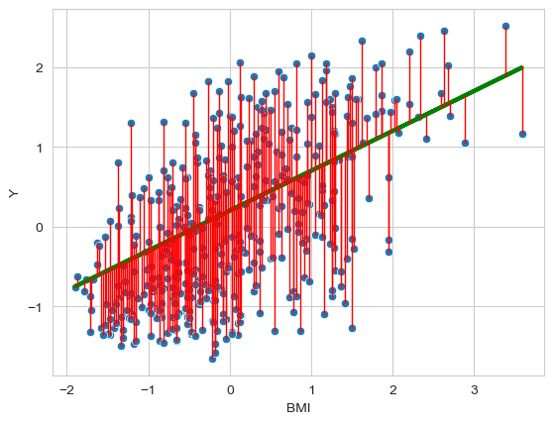
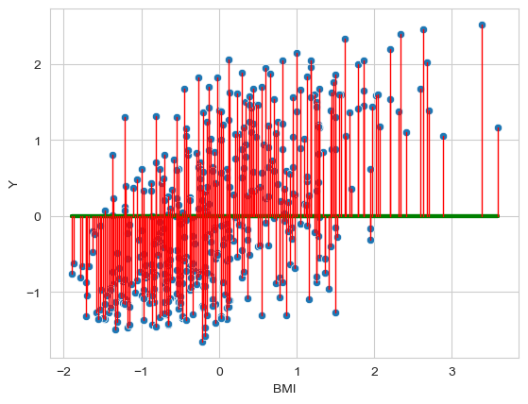
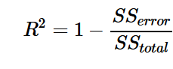
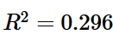
Linear regression: fitting
Machine Learning Methods for Biomedical Data (D012554)

Slide 53
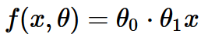
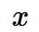
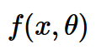


Linear regression: formalized
Dataset
linear regression
Learning Algorithm
Machine Learning Methods for Biomedical Data (D012554)

Slide 54


Linear regression: cost (loss function)
Machine Learning Methods for Biomedical Data (D012554)

Slide 55




Linear regression: cost (loss function)
Machine Learning Methods for Biomedical Data (D012554)

Slide 56


Linear regression
Fit a linear model
to the data set such that the cost function
is minimal.
Machine Learning Methods for Biomedical Data (D012554)

Slide 57

Learning (aka Training or Fitting): Gradient Descent
Gradient Descent is an optimization algorithm used to minimize a loss function by iteratively updating model parameters in the direction of the steepest descent (negative gradient).
The learning rate (𝛼) controls the step size of updates, where too large a value may cause divergence, and too small a value may lead to slow convergence.
Machine Learning Methods for Biomedical Data (D012554)
Notes:
The dashed line represents the slope of the blue curve at the starting point. Here's how it works:
The steepness of that line shows how big the gradient is.
The direction of the line tells us which way the cost function is increasing or decreasing.
Since we want to minimize the cost, we go in the opposite direction of the gradient (downhill).

Slide 58

Gradients
Machine Learning Methods for Biomedical Data (D012554)

Slide 59

Linear regression: cost (loss function)
Machine Learning Methods for Biomedical Data (D012554)

Slide 60




Gradient descent
Machine Learning Methods for Biomedical Data (D012554)

Slide 61



Gradient descent: learning rate
Machine Learning Methods for Biomedical Data (D012554)

Slide 62






Linear regression
model:
cost function:
Goal:
Learning: 1. start with some
2. change to reduce
3. repeat 2. until convergence
Machine Learning Methods for Biomedical Data (D012554)

Slide 63
Non-linear regression
Polynomial transformation creates higher-order features from the original features, allowing a linear model to learn complex, non-linear relationships in the data.
Linear regression or classification models can then fit non-linear patterns by treating these transformed features as inputs while still using a linear equation in the higher-dimensional space.
This effectively changes the decision boundary in the original feature space from a straight line to a curve, enabling the model to separate or fit data points that a purely linear model could not handle.
Machine Learning Methods for Biomedical Data (D012554)

Slide 64


Non-linear regression
Does y vary linearly with X?
Can we fit a non-linear model? Yes
Or we could add polynomial transformations of the features.
Machine Learning Methods for Biomedical Data (D012554)

Slide 65


Non-linear regression
Does y vary linearly with X?
Can we fit a non-linear model? Yes
Or we could add polynomial transformations of the features.
Machine Learning Methods for Biomedical Data (D012554)

Slide 66

Non-linear regression
Machine Learning Methods for Biomedical Data (D012554)

Slide 67


Classification
We need to make
assumptions
about the
model
that generated the data.
linear relationship
linear model
Machine Learning Methods for Biomedical Data (D012554)

Slide 68
Logistic regression
Logistic regression is a classification algorithm that predicts probabilities for binary or multi-class outcomes using the sigmoid function to map outputs between 0 and 1.
It models the relationship between input features and the probability of a class.
The decision boundary is defined by a threshold (typically 0.5), where predictions above the threshold are classified as one class and below as the other.
Optimization is performed using gradient descent to minimize the log loss (cross-entropy loss), ensuring the best separation of classes.
Machine Learning Methods for Biomedical Data (D012554)

Slide 69


Logistic regression
We need to make
assumptions
about the
model
that generated the data.
linearly separable
logistic model
Machine Learning Methods for Biomedical Data (D012554)

Slide 70


Logistic regression
Machine Learning Methods for Biomedical Data (D012554)

Slide 71


Logistic regression: cost (loss function)
Machine Learning Methods for Biomedical Data (D012554)

Slide 72


Logistic regression: cost (loss function)
Machine Learning Methods for Biomedical Data (D012554)
Notes:
X-as is predictie
Y-as is cost van predictie indien y == 1

Slide 73


Logistic regression: cost (loss function)
Machine Learning Methods for Biomedical Data (D012554)

Slide 74

Logistic regression
Fit a logistic model
to the data set such that the cost function
is minimal using gradient descent
Machine Learning Methods for Biomedical Data (D012554)
Notes:
Also convex!

Slide 75

Multiclass classification: one-against-all
Fit a binary classifier for each class.
Each binary classifier computes a probability prediction.
The class with the highest probability is predicted.
Machine Learning Methods for Biomedical Data (D012554)

Slide 76
Logistic regression
breast_cancer_classification.ipynb
Machine Learning Methods for Biomedical Data (D012554)

Slide 77

Logistic regression
Machine Learning Methods for Biomedical Data (D012554)

Slide 78

Logistic regression
Machine Learning Methods for Biomedical Data (D012554)

Slide 79

Model regularization
label noise
feature noise
feature relevance
relatively small train sets
don’t try to fit the data perfectly
don’t try to use all features
notice how R² on the train set does increase with d
Machine Learning Methods for Biomedical Data (D012554)

Slide 80
Model regularization
Model regularization prevents overfitting by adding a penalty term to the loss function, discouraging overly complex models that memorize noise instead of learning patterns.
L1 regularization (Lasso) adds the absolute values of weights, promoting sparsity by forcing some weights to become exactly zero, effectively selecting important features.
L2 regularization (Ridge) adds the squared values of weights, preventing large weight values and ensuring smooth generalization without eliminating features.
Elastic Net combines L1 and L2 penalties, balancing feature selection and weight shrinkage, making it useful for high-dimensional datasets with correlated features.
Machine Learning Methods for Biomedical Data (D012554)

Slide 81





Regularized linear regression
cost function
regularized cost function
Machine Learning Methods for Biomedical Data (D012554)

Slide 82



Regularized logistic regression
cost function
regularized cost function
Machine Learning Methods for Biomedical Data (D012554)

Slide 83


Regularized linear regression
Machine Learning Methods for Biomedical Data (D012554)

Slide 84


Regularized linear regression
Machine Learning Methods for Biomedical Data (D012554)

Slide 85
Support vector machine
Support Vector Machines (SVMs) are powerful classification algorithms that find the optimal hyperplane to separate data points into different classes with the maximum margin.
SVM uses support vectors, which are the closest data points to the decision boundary, to define and position the hyperplane, making it robust to outliers.
It can handle non-linearly separable data using the kernel trick, which transforms input features into higher-dimensional spaces (e.g., polynomial, radial basis function (RBF)) to make data linearly separable.
SVM is effective for both classification and regression (SVR) and works well with small to medium-sized datasets but can be computationally expensive for large datasets.
Machine Learning Methods for Biomedical Data (D012554)

Slide 86
Logistic regression: cost (loss function)
Machine Learning Methods for Biomedical Data (D012554)

Slide 87

Logistic regression: cost (loss function)
Machine Learning Methods for Biomedical Data (D012554)

Slide 88


Support vector machine: cost (loss function)
replace cost function by piecewise linear function
if y = 1 then the contribution to the cost is
Machine Learning Methods for Biomedical Data (D012554)

Slide 89

Support vector machine: cost (loss function)
replace cost function by piecewise linear function
if y = 0 then the contribution to the cost is
Machine Learning Methods for Biomedical Data (D012554)

Slide 90




Support vector machine: cost (loss function)
Fit a linear model
such that
with and
is minimized.
Machine Learning Methods for Biomedical Data (D012554)

Slide 91


Support vector machine: cost (loss function)
In this case the contribution to the cost needs to be small when the model predicts high values (>0) and large when the model predicts low values (<0).
For SVMs we see that the contribution to cost decreases linearly and becomes zero when
Machine Learning Methods for Biomedical Data (D012554)

Slide 92


Support vector machine: cost (loss function)
In this case the contribution to the cost needs to be large when the model predicts high values (>0) and small when the model predicts low values (<0).
For SVMs we see that the contribution to the cost is zero for
and then increases linearly.
Machine Learning Methods for Biomedical Data (D012554)

Slide 93


Support vector machine: cost (loss function)
Consider a train set with two classes that are perfectly linearly separable.
The piecewise cost function can be made zero.
The SVM objective can be written as
Machine Learning Methods for Biomedical Data (D012554)
Notes:
Error:C needs to be put outside!!

Slide 94

Machine Learning Methods for Biomedical Data (D012554)

Slide 95

Machine Learning Methods for Biomedical Data (D012554)

Slide 96

Support vector machine: large margin classifier
Machine Learning Methods for Biomedical Data (D012554)

Slide 97






Support vector machine: large margin classifier
red points statisfy
blue points satisfy
distance bewteen two dashed lines is
SVM objective was
Machine Learning Methods for Biomedical Data (D012554)

Slide 98
Support vector machine
Soft margin SVM allows some misclassification by introducing slack variables (𝜉) to handle overlapping classes, making the model more flexible when data is not perfectly separable.
It balances margin maximization and classification error using a regularization parameter (𝐶), where a small 𝐶 allows more misclassifications (wider margin), and a large 𝐶 forces stricter separation (narrower margin).
Soft margin SVM improves generalization by preventing overfitting in noisy or complex datasets while still maintaining a robust decision boundary.
Machine Learning Methods for Biomedical Data (D012554)

Slide 99


Support vector machine: soft margin
Machine Learning Methods for Biomedical Data (D012554)

Slide 100
Support vector machine: soft margin
Machine Learning Methods for Biomedical Data (D012554)

Slide 101
Support vector machine: soft margin
Machine Learning Methods for Biomedical Data (D012554)

Slide 102

Support vector machine: soft margin
Machine Learning Methods for Biomedical Data (D012554)

Slide 103


Support vector machine: regularization hyperparameter
Machine Learning Methods for Biomedical Data (D012554)

Slide 104
Support vector machine: kernels
The kernel trick allows SVM to handle non-linearly separable data by transforming input features into a higher-dimensional space where a linear decision boundary can be found.
Common kernel functions include Polynomial, Radial Basis Function (RBF), and Sigmoid, each mapping data to a different feature space to capture complex relationships.
It avoids explicitly computing high-dimensional transformations, making computations efficient while still benefiting from the power of non-linear feature mappings.
Machine Learning Methods for Biomedical Data (D012554)

Slide 105


Support vector machine: kernels
Machine Learning Methods for Biomedical Data (D012554)

Slide 106



Support vector machine: kernels
SVMs can also be formulated as a linear function of the samples (dual form) instead of the features as
where a model parameter is associated with a datapoint instead of a feature.
If we apply a polynomial transformation we obtain
Machine Learning Methods for Biomedical Data (D012554)

Slide 107



Support vector machine: kernels
Machine Learning Methods for Biomedical Data (D012554)

Slide 108




Support vector machine: kernels
Since the model only uses the dot product of the transformed feature vectors
we can replace that dot product by a kernel function
such that the model becomes
The data points for which are called the support vectors.
Machine Learning Methods for Biomedical Data (D012554)

Slide 109



Support vector machine: polynomial kernel
Machine Learning Methods for Biomedical Data (D012554)

Slide 110

Support vector machine: polynomial kernel
Machine Learning Methods for Biomedical Data (D012554)

Slide 111


Support vector machine: RBF kernel
Machine Learning Methods for Biomedical Data (D012554)

Slide 112
Ensemble methods
Decision trees serve as the foundation for ensemble methods like Random Forest and Gradient Boosting, which combine multiple trees to improve accuracy and robustness.
Ensemble learning reduces variance and bias, as bagging (e.g., Random Forest) decreases overfitting, while boosting (e.g., AdaBoost, XGBoost) enhances weak learners by correcting misclassified instances iteratively.
Machine Learning Methods for Biomedical Data (D012554)

Slide 113

Decision tree
advantages:
ease of interpretation
handles continuous and discrete features
invariant to monotone transformation of features
variable selection automated
low bias (deep trees)
disadvantages:
high variance
overfitting
Machine Learning Methods for Biomedical Data (D012554)

Slide 114
Bias and variance
Bias refers to the error introduced by approximating a complex problem with a simple model, leading to underfitting when the model fails to capture the underlying patterns in the data.
Variance measures the model's sensitivity to small fluctuations in the training data, causing overfitting when the model learns noise instead of general patterns.
The bias-variance tradeoff is a fundamental concept in machine learning, where reducing bias increases variance and vice versa, requiring a balance for optimal model performance.
Machine Learning Methods for Biomedical Data (D012554)

Slide 115

Bias and variance
Error due to bias
Error due to variance
Irreducible error
Machine Learning Methods for Biomedical Data (D012554)

Slide 116

Bias and variance
Error due to bias
Error due to variance
Irreducible error
Machine Learning Methods for Biomedical Data (D012554)

Slide 117
Bagging and boosting
Bagging (Bootstrap Aggregating) reduces variance by training multiple models on different random subsets of the data, then averaging their predictions (for regression) or using majority voting (for classification), as seen in Random Forest.
Boosting sequentially trains models where each model corrects the errors of the previous one, improving weak learners incrementally, as used in AdaBoost, Gradient Boosting, and XGBoost.
Bagging is effective for high-variance models (e.g., decision trees) by stabilizing predictions, while boosting is useful for reducing bias by focusing on difficult-to-classify instances.
Both methods enhance predictive accuracy in ensemble learning, with bagging excelling in variance reduction and boosting providing strong performance on complex datasets.
Machine Learning Methods for Biomedical Data (D012554)

Slide 118
Bagging and boosting
boosting
bagging
Machine Learning Methods for Biomedical Data (D012554)

Slide 119

Bagging
Simulate the notion of different train set samples:
sample data points from train set to create new train set
fit low bias high variance model on new train set
repeat steps (1) and (2) T times
average the predictions of the T models
Machine Learning Methods for Biomedical Data (D012554)

Slide 120
Bagging: Random Forest
Train set contains n data points with m features.
Construct T low bias high variance decision trees by following these steps:
Sample n data points at random with replacement from the train set.
At each node, select h<<m features at random and compute the best split using only these h features.
Each tree is grown to the largest extent possible. There is no pruning or early stopping.
Step 3 ensures that the bagged models are low bias by learning deep complex decision trees.
Machine Learning Methods for Biomedical Data (D012554)

Slide 121

Bagging: Random Forest
Machine Learning Methods for Biomedical Data (D012554)

Slide 122

Boosting
reduce the bias of a high bias low variance model
turning an ensemble of weak learners into a strong learner
the meta-model is additive, i.e. Adaboost:
Machine Learning Methods for Biomedical Data (D012554)

Slide 123


Boosting: Adaboost
Machine Learning Methods for Biomedical Data (D012554)

Slide 124

Boosting: Adaboost
Machine Learning Methods for Biomedical Data (D012554)

Slide 125

Boosting: Adaboost
The weight of a weak model in the boosted meta-model increases exponentially as the error approaches 0. Better models are given exponentially more weight.
The weight is zero if the error rate is 0.5. A model with 50% accuracy is no better than random guessing, so it is ignored.
The weight decreases exponentially as the error approaches 1. A negative weight is given to classifiers with worse than 50% accuracy. “Whatever that classifier says, do the opposite!”.
Machine Learning Methods for Biomedical Data (D012554)

Slide 126

Boosting: Adaboost
Machine Learning Methods for Biomedical Data (D012554)

Slide 127




Boosting: Gradient boosting
Machine Learning Methods for Biomedical Data (D012554)

Slide 128

Boosting: Gradient boosting
Machine Learning Methods for Biomedical Data (D012554)

